Slide 1
Data Sci-BOT
Internal Guide :
Dr. P. Deepalakshmi
Team Members:
G. Lok Sundar
N. Yaswanthi
Babloo Kumar

Slide 2
Abstract
In this project, Our goal is to build an AI-based Sci-bot which will do the whole work of a Data Scientist on its own and it will tell the Final Data Analysis Observation to the Stakeholder/client.

Slide 3
Literature Survey
S.No | Paper | Author | Journal | Description
1 | Learning Feature Engineering for Classification | Fatemeh Nargesian, Horst Samulowitz, Udayan Khurana Elias B. Khalil, Deepak Turaga | Proceedings of the Twenty-Sixth International Joint Conference on Artificial Intelligence (IJCAI-17) | In this paper, they discussed the automated feature engineering techniques. Existing approaches to automating this process rely on either transformed feature space exploration through evaluation-guided search or explicit expansion of datasets with all transformed features followed by feature selection. Such approaches incur high computational costs in runtime and/or memory. For this, they presented a novel technique, called Learning Feature Engineering (LFE).

Slide 4
S.No | Paper | Author | Journal | Description
1 | Bayesian Optimization with Unknown Search Space | Huong Ha, Santu Rana, Sunil Gupta, Thanh Nguyen, Hung Tran-The, Svetha Venkatesh | 33rd Conference on Neural Information Processing Systems (NeurIPS 2019) | In this paper, they Implemented the new way of optimizing the features space which is unknown to the best fit data can do. To address this problem, they propose a systematic volume expansion strategy for Bayesian optimization. They devise a strategy to guarantee that in iterative expansions of the search space, our method can find a point whose function value within Epsilon of the objective function maximum. Without the need to specify any parameters, our algorithm automatically triggers a minimal expansion required iteratively.

Slide 5
Existing system
Presently The automation is Limited to Machine Learning it didn’t come to Data Science still Researches are going on to automate the Data Scientist Process
At present all the Data analysis part is done by human Physically, and the time required for the project also up to one month for each case study.

Slide 6
Isuues In existing Sysytem
High Investment- since the data scientist salary is a high company has to pay more to data scientists.
Time taking – Data scientists are to be trained for up to 6 months to work in real-time companies.
Error/Mistakes– Humans may do mistakes sometimes.
Need a Domain Expertise to create a story for Stake Holders.

Slide 7
Proposed System
The Main Goal is to create a Bot that can use the data and Prepare an Analysis story on it as Data Scientists do.
In this project we are particularly doing on Case study on Employee attrition.
In this our Sci-bot takes the data in and it does all the Data analysis part by itself and finally it creates a story on its self and explains it to the stakeholders/clients.
In the AI algorithm the Sci-bot takes the best algorithm for the problem using Auto-Machine Learning Methods.
It will automatically take the best parameters for each algorithm using a grid search and Bayesian optimization Technique.
Finally to the client everything is internal but the final output is a story that the client will understand.

Slide 8
Advantages of Proposed Work
It can replace Data Scientist
No work place for Data Scientist’s.
Errorless : Humans may do mistakes but machines doesn’t.
Money Efficient, One time buy algorithms it will run for the entire life.

Slide 9
Software requirement specification
Windows 10 or above with high computational power.
Python 3.0 or above
Jupyter notebook, Spyder ,Anaconda platforms
Voice software for telling stories.

Slide 10
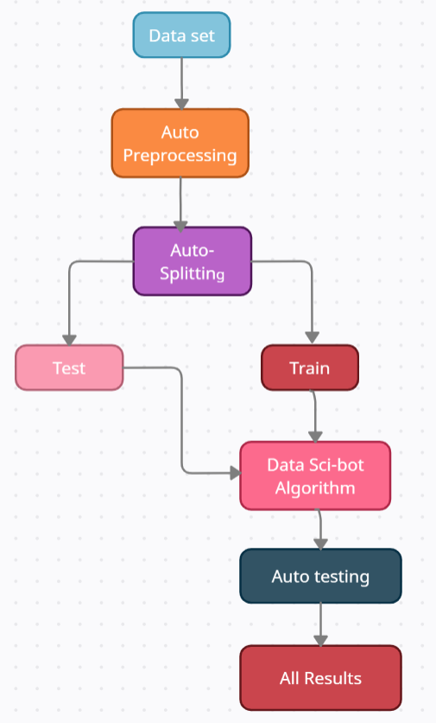
Methodologies 1) Over-all Data Flow step

Slide 11
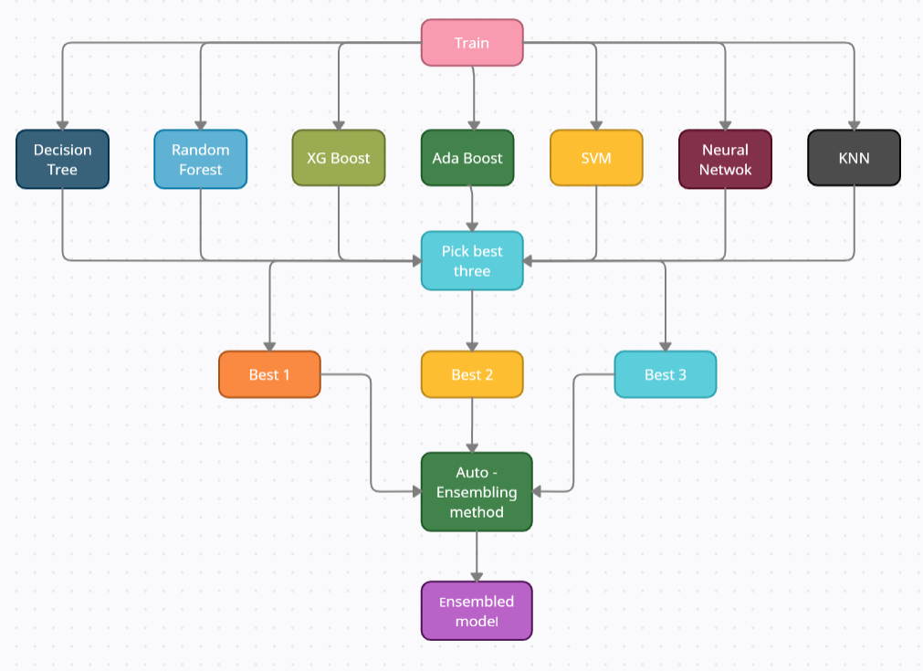
2) Sci-Bot Algorithm step

Slide 12
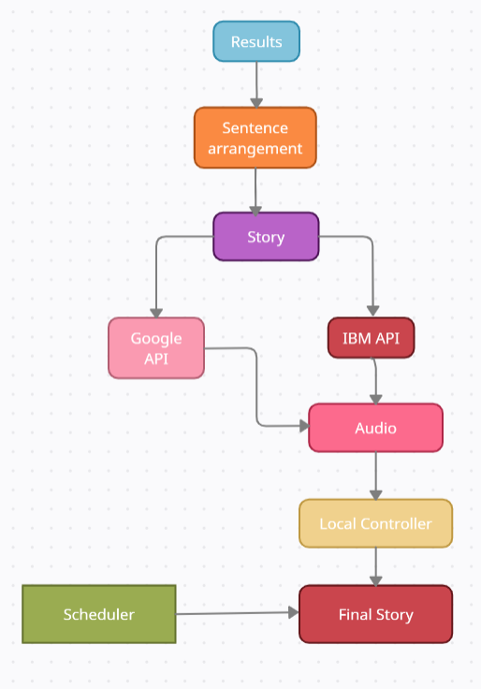
3) All Results to Story step.

Slide 13
Schedule of the project
17 Aug to 31 Aug - Brain storming ideas , selecting the right project.
1 Sep to 15 Sep - Analysis of existing system and their drawback and Literature Survey.
16 Sep to 15 Oct - Deciding the right case study and Data set collection.
16 Oct to 15 Nov - Demo Trails and Demo Models.
16 Nov to 15Dec - Model building upto Data Processing
1 Jan to 15 Feb - Model Building
15 Feb to 15 Mar - Model Deployement and Paper Publishing.
15 Mar to 15 Apr - Preparation for final review.

Slide 14
Roles And responsibilities
N.Yaswanthi – Build the basic Machine Learning Model and Data Analysis Process.
Babloo Kumar – Automate the Machine Learning model and Data Analysis Process.
G.Lok Sundar – Automates the Optimization of Machine Learning algorithms and also Writes an algorithm to create a story and let the machine to tell the story to the stakeholder/client.

Slide 15
References
Fatemeh Nargesian, Horst Samulowitz, Udayan Khurana Elias B. Khalil, Deepak Turaga. Learning Feature Engineering for Classification, Proceedings of the Twenty-Sixth International Joint Conference on Artificial Intelligence (IJCAI-17).
Huong Ha, Santu Rana, Sunil Gupta, Thanh Nguyen, Hung Tran-The, Svetha Venkatesh, Bayesian Optimization with Unknown Search Space, 33rd Conference on Neural Information Processing Systems (NeurIPS 2019).
Nagadevara, V., Srinivasan, V. & Valk, R. (2008). Establishing a Link between Employee Turnover and Withdrawal Behaviours: Application of Data Mining Techniques, Research and Practice in Human Resource Management, 16(2), 81-99.
Pankaj Ajit, “Prediction of Employee Turnover in Organizations using Machine Learning Algorithms A case for Extreme Gradient Boosting” International Journal of Advanced Research in Artificial Intelligence, Vol. 5, No. 9, 2016.
Joao Marcos de Oliveira, Matthäus P. Zylka, Peter A. Gloor, and Tushar Joshi:” Mirror, Mirror on the Wall, Who Is Leaving of Them All: Predictions for Employee Turnover with Gated Recurrent Neural Networks” © Springer Nature Switzerland AG 2019 Y. Song et al. (eds.), Collaborative Innovation Networks, Studies on Entrepreneurship, Structural Change and Industrial Dynamics, https://doi.org/10.1007/978-3-030-17238-1_2 .

Slide 16
Thank you

